Slide 1
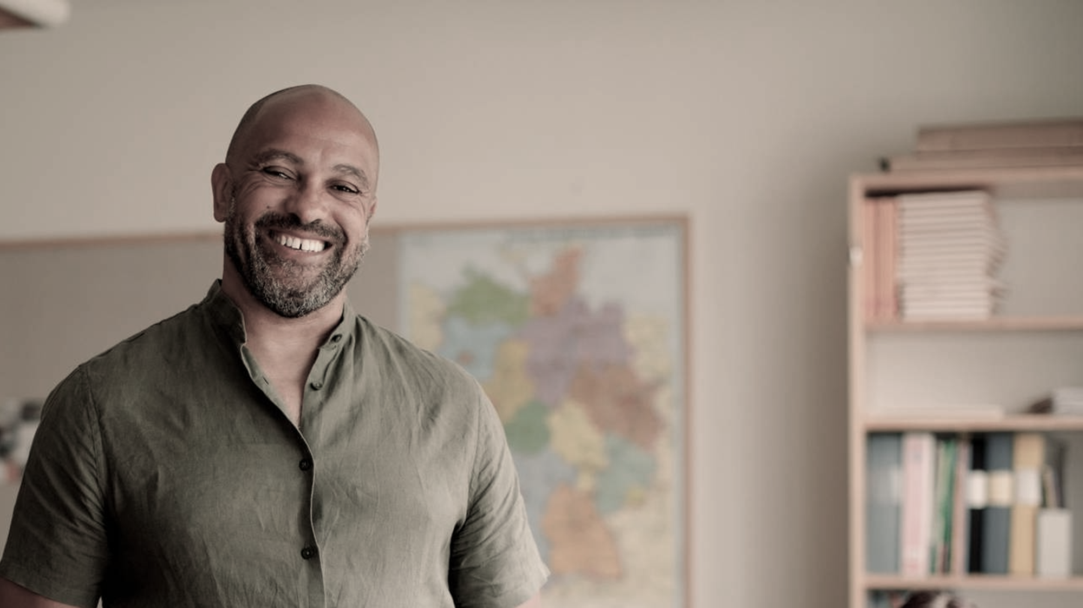
ZAMLEARN
education through basic phones using IVR-based educational system in Zambia

Slide 2

PROBLEM
Education in rural Zambia faces significant challenges with 65% of students lacking access to quality resources. The technology gap is pronounced as only 17% of rural households have smartphones or computers. Infrastructure limitations manifest in unreliable internet connectivity across 78% of rural communities. Students encounter frequent learning disruptions due to weather conditions, teacher shortages, and economic factors. This educational inequality is reflected in national exam results, where rural students score 42% lower than their urban counterparts. The combination of limited technology access and infrastructure challenges creates a persistent educational divide that traditional solutions have failed to bridge.`

Slide 3
SOLUTION
ZamLearn IVR delivers educational content through basic mobile phones using Interactive Voice Response technology, making learning accessible without smartphones or internet. Our voice-based learning system works on any basic mobile phone, ensuring education reaches the most remote areas. Content is delivered in English and seven major Zambian languages, making education culturally relevant and accessible. The system operates 24/7, allowing learning to continue outside school hours and during school closures. All content is carefully mapped to the Zambian national curriculum, ensuring students receive education that prepares them for national examinations and meets official standards.

Slide 4
PRODUCT
The ZamLearn IVR platform centers around a toll-free number that students can call from any basic phone to access educational content. Our comprehensive audio lessons cover mathematics, science, English, and social studies with content designed specifically for auditory learning. The interactive quiz feature provides immediate feedback to reinforce concepts and assess understanding. Each student receives a unique ID enabling progress tracking across subjects and lessons. Teachers receive support through a dedicated line providing instructional guidance and teaching tips. Key concepts and homework assignments are reinforced through supplementary SMS messages. Our local content hub ensures examples and scenarios are culturally relevant to Zambian students, enhancing comprehension and engagement.

Slide 5
TARGET MARKET
ZamLearn IVR primarily serves students aged 10-18 in rural Zambian provinces who have limited access to educational resources but can access basic mobile phones. Public schools in remote areas with limited infrastructure and learning materials form our institutional market base. Community learning centers in underserved regions represent another key segment where our solution can have immediate impact. Secondary markets include adult learners seeking basic education, teacher training programs needing remote delivery options, and government education initiatives targeting underserved populations. Our initial focus concentrates on the Northern, Eastern, and Western provinces which show the lowest education indicators in the country while having sufficient basic mobile phone coverage.

Slide 6
MARKET SIZE
The total addressable market encompasses 3.2 million students across Zambia, representing an annual value of ZMW 960 million. Within this, our serviceable available market comprises 1.9 million rural students valued at approximately ZMW 570 million annually. Our serviceable obtainable market focuses on 320,000 students in our target provinces, representing a ZMW 96 million opportunity. Mobile phone penetration stands at 78% of rural households having access to at least one basic mobile phone, making our solution viable even in remote areas. The growth potential remains strong with a 12% annual increase in mobile phone adoption in rural areas, expanding our potential user base each year.

Slide 7
COMPETITORS
The educational landscape in rural Zambia includes radio education programs which, while accessible, lack the interactivity and personalization our system provides. SMS-based learning platforms exist but require literacy and offer text-only experiences that limit engagement for younger students. Indirect competition comes from traditional distance learning programs using paper materials, which suffer from distribution challenges and delayed feedback. Periodic mobile schools visit remote areas but offer inconsistent access. Community education initiatives provide valuable supplementary learning but lack systematic curriculum alignment. Current solutions fail to combine accessibility, interactivity, comprehensive curriculum coverage, and progress tracking in a single platform – the precise gap ZamLearn IVR addresses.

Slide 8
COMPETITIVE ADVANTAGE
ZamLearn IVR offers unmatched accessibility by functioning on any basic phone without requiring internet connectivity, reaching students where other digital solutions cannot. Our cost structure enables service at ZMW 25 per student monthly, compared to ZMW 120 for SMS-learning platforms, making education affordable for low-income communities. Unlike one-way radio broadcasts, our system provides interactive learning with real-time engagement and assessment. The curriculum is precisely aligned with national examination requirements, ensuring learning directly contributes to academic success. Multi-language support reaches non-English speakers often excluded from educational innovations. Our technology functions completely offline, independent of internet connectivity issues. The built-in data analytics enable student progress tracking for targeted interventions. Finally, our established partnerships with telecom providers and the education ministry provide operational advantages and institutional credibility that new entrants would struggle to replicate.

Slide 9
TRACTION & ROADMAP
ZamLearn IVR has demonstrated strong potential through a successful 3-month pilot with 1,200 students across 8 schools, achieving an 87% lesson completion rate and driving a 23% improvement in test scores. We have secured Memorandums of Understanding with two major telecom providers to ensure favorable calling rates. Our development roadmap begins with launching in Northern Province reaching 50,000 students by Q3 2025, followed by expansion to Eastern Province adding 75,000 more students in Q1 2026. The Western Province expansion will bring in another 95,000 students by Q3 2026. In 2027, we will develop an advanced analytics dashboard for education officials to track regional performance. By 2028, we aim to achieve nationwide coverage with enhanced features serving students across all Zambian provinces.

Slide 10
BUSINESS/REVENUE MODEL
ZamLearn IVR implements a multi-stream revenue model centered on institutional partnerships. Government education contracts will provide ZMW 20 per student monthly, accounting for 70% of our revenue. NGO partnerships will generate program sponsorships at ZMW 30,000 per school annually, representing 15% of revenue. Corporate CSR Programs will contribute through ZMW 250,000 annual sponsorships, forming 10% of our income. Premium content subscriptions priced at ZMW 35 monthly for advanced materials will generate the remaining 5%. Our unit economics are structured for sustainability with a cost per student of ZMW 15 monthly against revenue of ZMW 25-40 monthly, yielding a healthy gross margin of 40-60%. The business model projects a break-even point at 85,000 active users, achievable within our initial 18 months of full operation.

Slide 11
GO-TO-MARKET STRATEGY
Our approach unfolds in three strategic phases. In Phase 1, we will establish the foundation by partnering with the Ministry of Education to secure curriculum approval and endorsement. Simultaneously, we will finalize telecom partnerships to negotiate discounted or free call rates critical to our cost structure. We will implement a comprehensive pilot in 25 schools across target provinces to demonstrate effectiveness. Phase 2 focuses on regional launch by working directly with district education boards to facilitate local implementation and buy-in. We will train teacher champions in each participating school to provide on-ground support and drive adoption. Community awareness campaigns through radio and local leaders will educate families about the system's benefits. Phase 3 scales the operation by leveraging pilot data to secure government contracts for broader implementation. We will partner with rural NGOs for distribution support and community engagement. A referral program will incentivize school participation by offering resources based on adoption rates.

Slide 12
OUR ASK
We are seeking an investment of ZMW 2.5 million to bring ZamLearn IVR to scale. This funding will be allocated with ZMW 1.2 million dedicated to technical development and infrastructure, ensuring robust system performance even in challenging conditions. Content development and localization will require ZMW 600,000 to create curriculum-aligned materials in multiple languages. Marketing and community outreach initiatives will utilize ZMW 400,000 to drive awareness and adoption in target regions. The remaining ZMW 300,000 will support operations and team expansion to manage growth. This investment structure is projected to yield break-even results within 18 months of full operation, with a 3.2x ROI anticipated within 3 years. Beyond financial returns, the investment will drive social impact reaching over 320,000 students by 2028, transforming educational access across rural Zambia.

Slide 13


THE TEAM
Mrs. Esnart Kaela kalimina0
Our leadership consists of experienced professionals committed to educational transformation in Zambia.
Our CEO. Our CTO
Mr Flemings Alan Kalimina

Slide 14

Thank you
Flemings kalimina Esnart K Kalimina
Esnartkaela20@gmail.com
Flemingssecond@gmail.com

